Slide 1
Railway Management System
Design pattern : Factory method

Slide 2
Intent
“Define an interface for creating an object, but let subclasses decide which class to instantiate”
It lets a class defer instantiation to subclasses at run time.
It refers to the newly created object through a common interface.

Slide 3
Problem
A framework needs to standardize the architectural model for a range of applications, but allow for individual applications to define their own domain objects and provide for their instantiation.

Slide 4
forces
It is required to have a set of reusable classes which are flexible enough to be extended.
The client does not know the type of object that need to be created in advanced and still want to perform operations on them.

Slide 5
Applicability
Factory Method is needed when :
A class can’t anticipate the class of objects it must create.
A class wants its subclasses to specify the objects it creates.
Localization of knowledge of helper sub classes which the classes want to delegate.

Slide 6
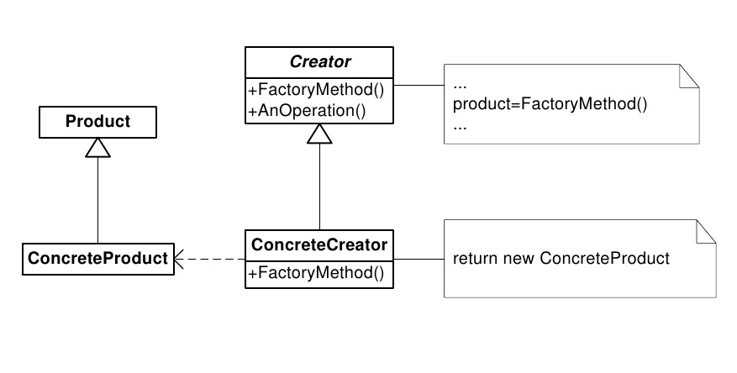
Basic structure

Slide 7
Collaborators
The creator relies on the subclass’s factory method and return instance of appropriate ConcreteProduct object.
The Creator executes some sequence of operation on the object.

Slide 8
Consequences
The code deals with only with the product interface, therefore it can work with any user defined Concrete Product classes (decoupling subclass details from client classes).
New concrete classes can be added without recompiling the existing code.
It may lead to many subclasses if the product objects requires one or more additional objects. (Parallel class hierarchy)

Slide 9
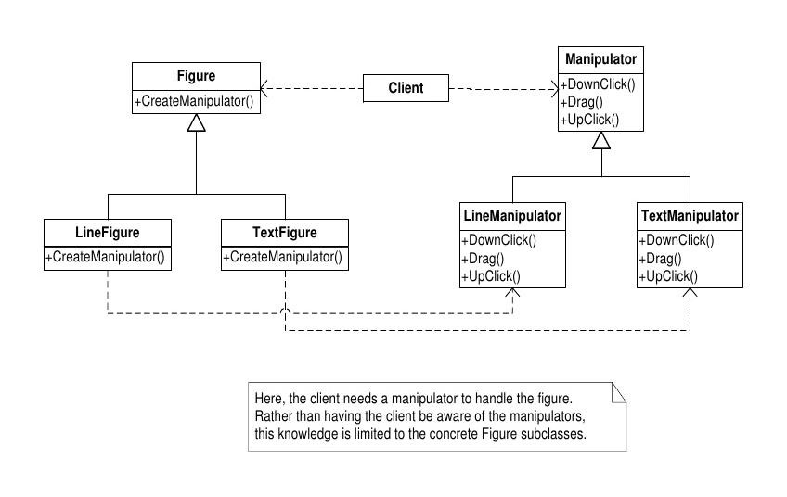
consequences – (cont.)

Slide 10
Implementation
Two major varieties
Abstract Creator class with no default implementation
Concrete Creator with default implementation
Solution:
Parameterized Methods
Templates

